Slide 1

The Olde Cheese Shoppe
Customer Satisfaction Report
Notes:
Today we will discuss the customer satisfaction report of The Olde Cheese Shoppe and improvements the store can make.

Slide 2

Research Objective
To determine what factors contribute most to customer satisfaction among the target market.
Notes:
To determine the factors that contribute the most to customer satisfaction we will use both a focus group and a survey to collect information from customers.

Slide 3
Research Questions
1. What is the overall satisfaction with the customer experience provided at The Olde Cheese Shoppe?
2. Is The Olde Cheese Shoppe meeting customer expectations regarding the selection of cheeses being offered?
3. Are customers generally satisfied with the service being provided by the staff?
4. Are there any additional services that customers want that are not being offered?
Notes:
These 4 questions address the most important factors for customer satisfaction. They include selection of product and customer service. They also ask if there are any additional services missing from what is offered, which is important incase there is a factor we did not think of. Answering these questions will allow The Olde Cheese Shoppe to determine what are the most important things to fix to improve customer satisfaction.

Slide 4
Background
2 New competitors are opening in the area
Located in San Francisco
Notes:
The catalyst prompting this market research for The Olde Cheese Shoppe is the 2 new competitors opening in San Francisco.

Slide 5
Executive Summary
Prices are slightly too high according to the survey
Create a rewards program
Selection of cheeses is too small
Increase the amount of gourmet and imported cheese
The shop’s environment is an important factor
Teach the employees about the cheese
Notes:
Between the survey and focus group three main issue arose. The first is that the prices are slightly too high for many of the customers. This can be resolved by introducing a rewards program that does two things. One it lowers the price for loyal customers and second it encourages customers to keep coming back.
The second issue is that the selection of cheeses are too small. Specifically, the customers want more gourmet and imported cheese. This can easily be resolved by increasing the options of these cheeses.
The third factor that arose is that customers treat the store as more than just a place to buy their cheese. They enjoy spending time in the store in general. In order to enhance this experience, the shop could teach their employees more about the cheese. This way the customers can talk to the employees about the cheeses that are available as well as get recommendations on which to buy.

Slide 6
Methodology
Population for the survey: 414 (people in San Francisco that subscribe to Cheese Gourmet magazine)
Desired sample size:100
Actual sample size: 256
Margin of Error: 6.25%
Confidence Level: 95%
Notes:
The population of 414 Cheese Gourmet subscribers should accurately represent the customers in San Francisco that shop at The Olde Cheese Shoppe.
A sample size of at least 100 would accurately represent the opinions of the subscribers.
The actual sample size we got is 256, which is great since it is significantly higher than our desired size.
This larger sample size lowers our margin of error to 6.25% which means we can be confident in the data.
Our confidence level that the data is within 6.25% of the true population is 95%.

Slide 7

Methodology
Response rate: 61.8%
This was an extremely high response rate
The popularity of the store may have pushed more people to respond to the survey
Some readers may not have noticed the survey which could lower the response rate
Notes:
The response rate of 61.8% was amazing. This could have happened because many of the Cheese Gourmet readers like The Olde Cheese Shoppe. The number could have potentially even been higher if not all readers saw the survey in the magazine.

Slide 8
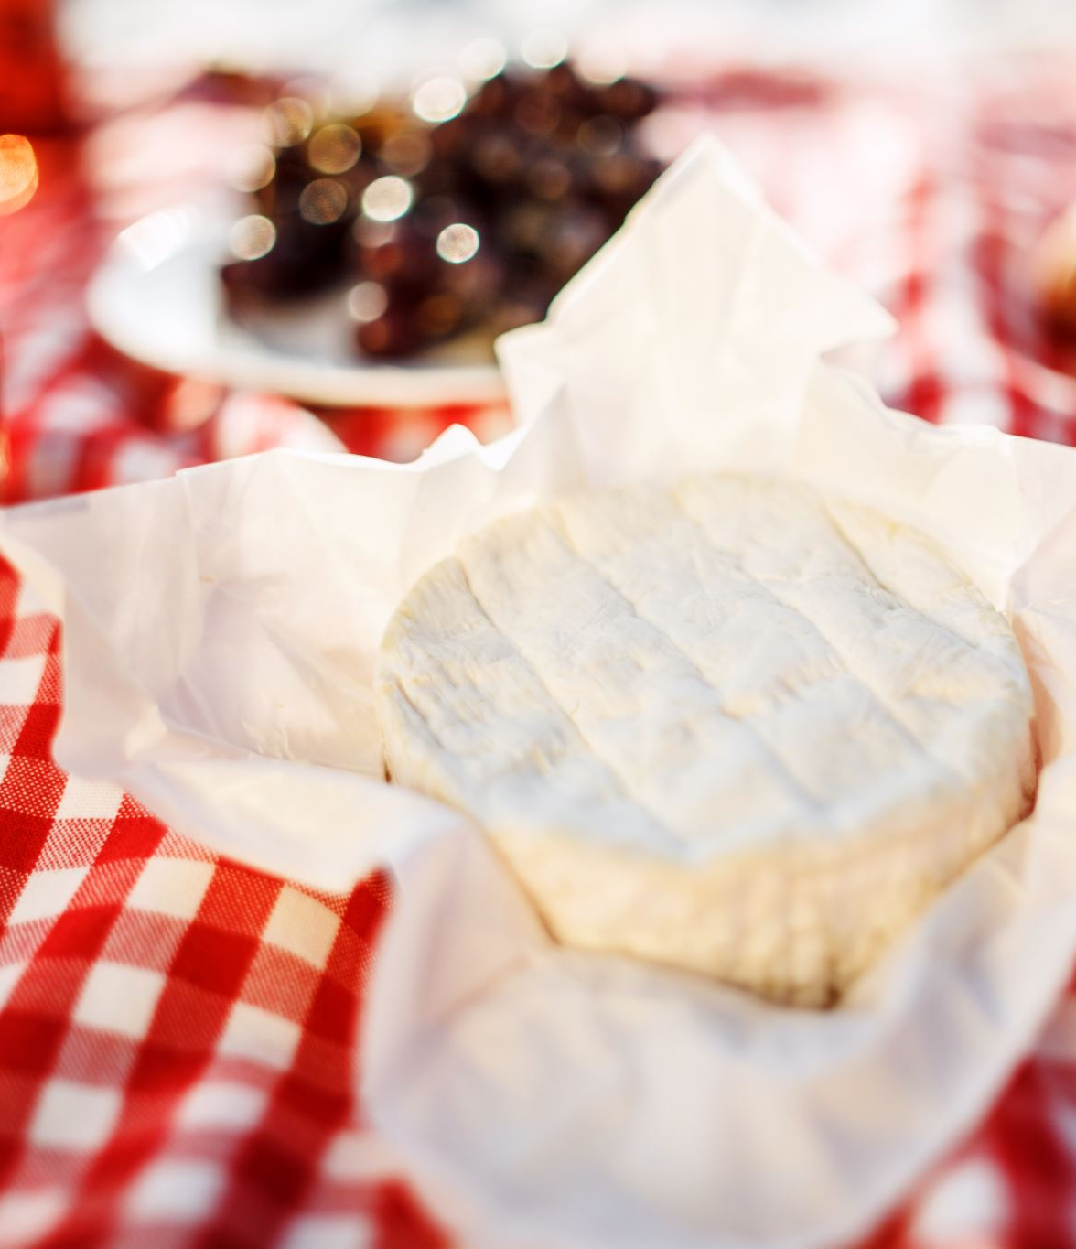
Qualitative Evaluation – Focus Group
Not enough gourmet cheese selection
Seven participants stated the selection of gourmet cheeses is of primary importance
Some respondents said there are “not many choices of gourmet cheeses”
Six participants stated that they try to purchase domestic gourmet cheeses, but those cheeses are not always available from some stores
Notes:
One of the major findings from the focus group was that there are not enough gourmet cheese options. Specifically, half of them wanted more domestic gourmet cheeses. Having a wide selection of gourmet cheeses was a primary factor for 7 of the participants when choosing where to shop for their cheese.

Slide 9
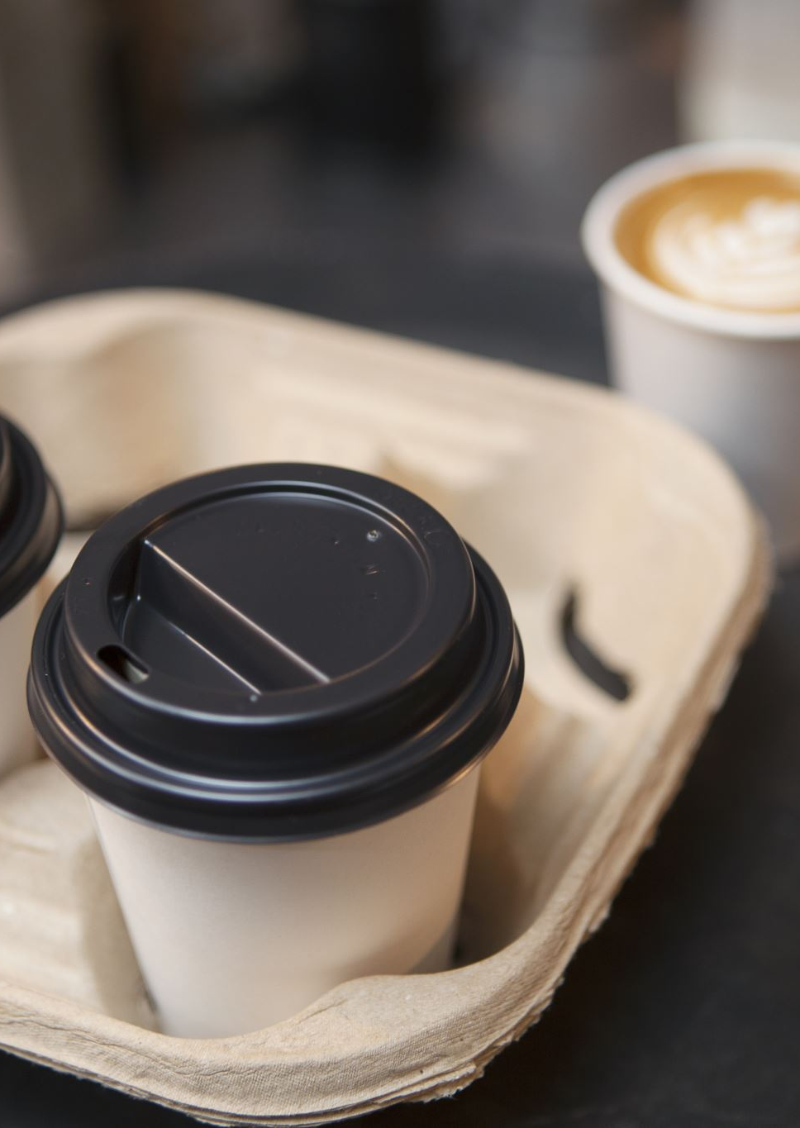
Qualitative Evaluation – Focus Group
Atmosphere is an important factor for choosing a cheese shop
Eight participants like to spend time there beyond making their cheese purchases
Most participants enjoy the décor, which reminds them of an old-time grocery store
Seven participants stated that they usually buy coffee, a beverage, and/or a snack as well as cheese
Owner very knowledgeable, but staff cannot always answer questions about cheeses
Notes:
The second major insight we got from the focus group was that there are other factors besides the cheese that determine where a customer likes to shop for their cheese. This was shown by 8 of the participants stating that they like to spend time in the shop beyond just buying cheese.
One of the things the participants thought The Olde Cheese Shoppe does well is décor as well as their offerings of coffee, beverages, and snacks.
However, something the participants thought could improve the experience was the staff being more knowledgeable about the cheeses. The owner was able to answer questions the customers have but the staff was not able to as well. Teaching the staff would also help the staff be able to make recommendations for what cheese to buy, which was another thing that the focus group thought was an issue.

Slide 10
Survey Analysis
The shop could greatly benefit from increasing the selection of cheeses
Notes:
The lowest rating The Olde Cheese Shoppe got from the survey was the amount of imported cheese options. The second lowest response was the overall selection of cheeses. Since the focus group thought there were not enough gourmet cheeses, focusing on increasing both the imported cheeses and gourmet cheeses would help resolve the overall selection satisfaction.

Slide 11
Survey Analysis
The second major factor that scored low on the survey was the pricing
This factor scored low among all age groups except for 31-40
Notes:
All other scores on the survey were above a 4 out of 5 besides the cheese selection and pricing. So, the pricing is the only other key insight from the survey in terms of things The Olde Cheese Shoppe could improve on. The pricing was an issue for all age groups as well, except for 31-40, but even they showed some room for improvement with a 4 out of 5.

Slide 12
Recommendations
Rewards Program
Increase selection of Imported and Gourmet Cheeses
Teach Employees more about the cheeses
Notes:
Creating a rewards program for customers that gives returning customers discounts on cheese would help address the issue of reasonable pricing. It will also allow the shop to discount cheese that they need to sell because of overstock or cheese that will expire soon to create less waste. It would even encourage customers to keep returning to The Olde Cheese Shoppe, increasing customer loyalty.
Increasing the selection of gourmet cheese and imported cheese will address the issue that both the focus group and survey results returned of not enough selection of cheeses. This was determined to be the most important factor when selecting a cheese shop. So, addressing this issue is of utmost importance in order to stay competitive with the new competition.
Finally having the employees learn more about the cheeses. One of the important factors for selecting a cheese shop is spending time there outside of buying cheese. If the employees are more knowledgeable it allows the customers to talk to the employees about the different cheeses, as well as the employees being able to give good recommendations to the customers.

